Slide 1
TV influence on US Presidential Race
Octav Dragoi, Michal Hetmanczuk, Duc Tung Nguyen

Slide 2
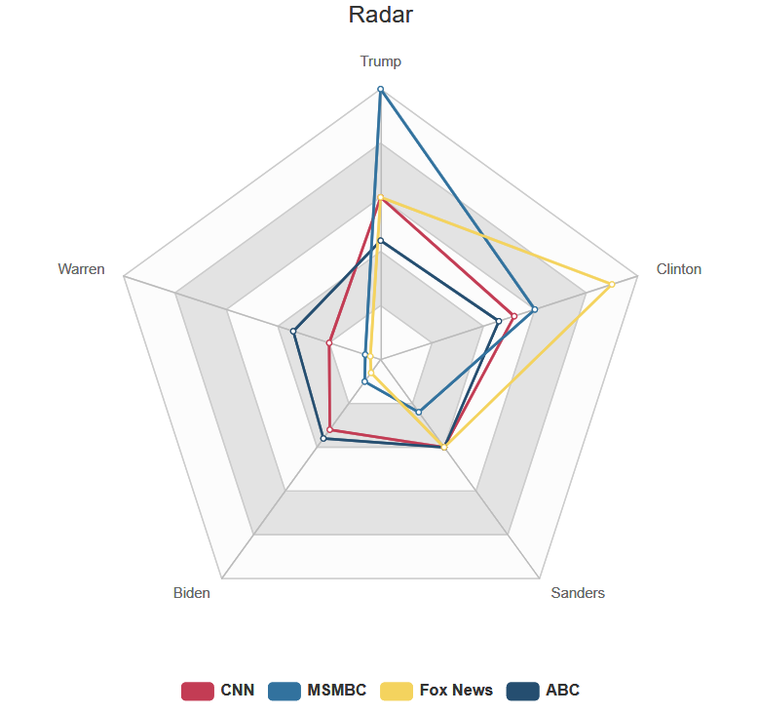
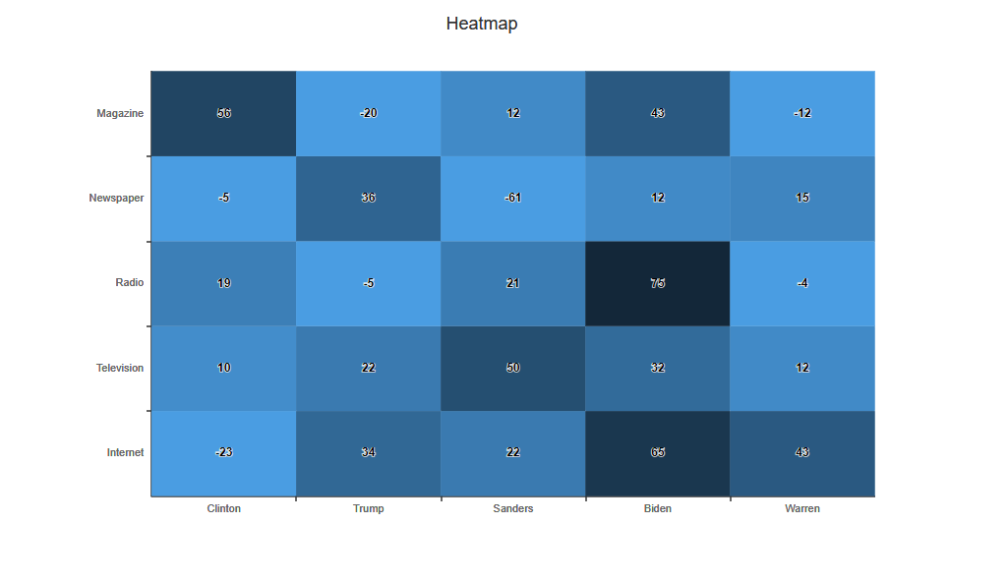



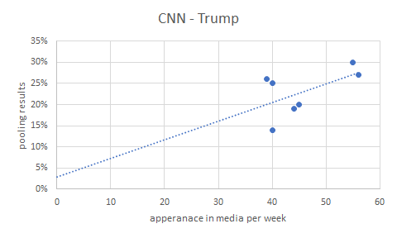
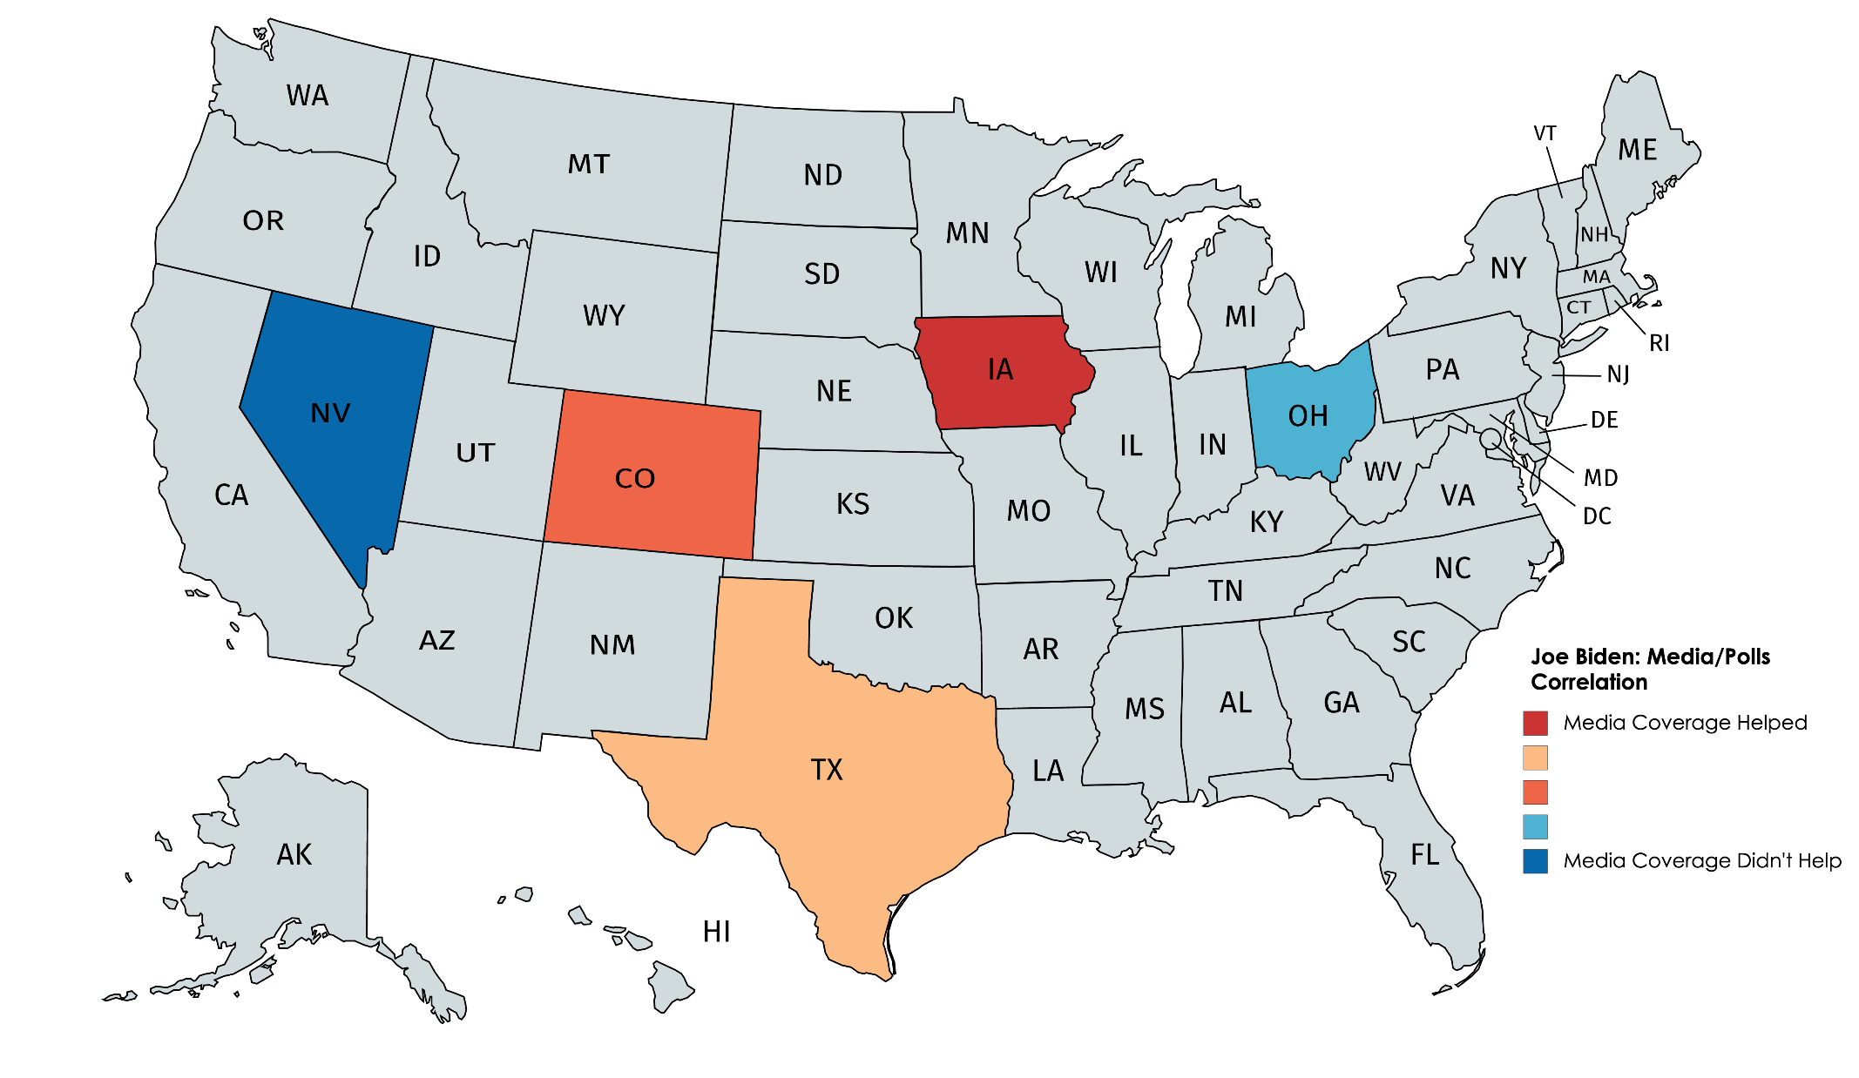

Our goal

Slide 3
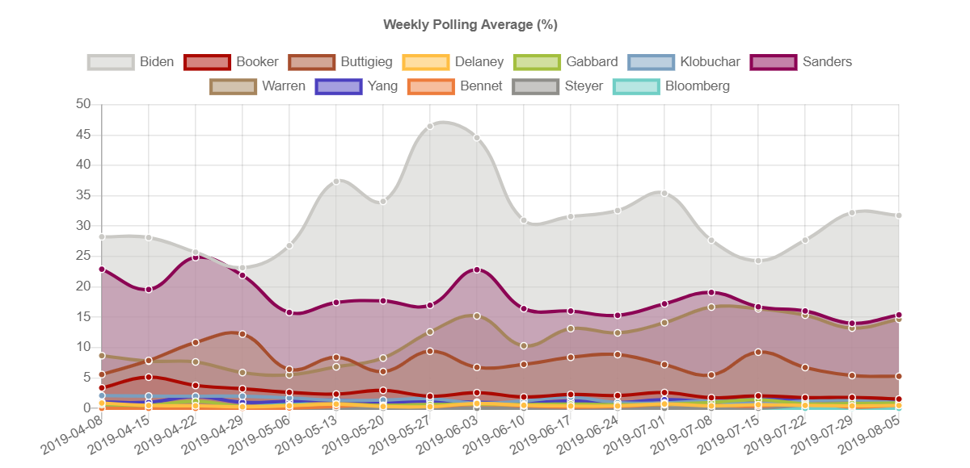
Our results
Notes:
No websites data, no US Map

Slide 4
Demo

Slide 5

Datasets - reminder

Slide 6
Division of work
Octav | Michał | Tung
- Form design and integration - Data loading in Python - Chart.js charts - Website layout and text | - GDelt API work - Dynamic text - Radar chart, heatmap | - Database design, migration - Automated population

Slide 7
Problems encountered
Poor knowledge of Django at the beginning
Difficulty in integrating libraries
Processing of raw dataset data
Data connection: media coverage - polling
Handling and analysis of Gdelt data
Not enough data for specific states (most data is US-level)

Slide 8
Technology stack - reminder
Frameworks:
Django
Components:
HTML, CSS, JavaScript, jQuery, AJAX, plotly, ChartJS
Tools:
PyCharm, npm, SQLite 3

Slide 9
Technology stack - Pros and Cons
Technology | Pros | Cons
Django | - Prescriptive solution for all our needs | - Inflexible at times - Hard to integrate with modern front end frameworks - Require deeper understanding of web development
SQLite 3 | - Lightweight, integrated with Django - Easy to use | - Huge pain to migrate off to something; to scale; - Some SQL commands not supported
Chart.js | - Dynamic, responsive charts | - Poor Django integration
Bootstrap Table | - Clean, simple tables | - Not too customizable
Node.js | - Used as package manager for front end | - Overlapping functionality with Django

Slide 10
Performance analysis
Data and logic are integrated in the Python backend. Computation is done server-side, in Python, can take up to 5 seconds to run a query.
Main bottlenecks: data duplication and processing.
Decoupling data and computation services would help with scalability.
For runtime speedup, we can try caching queries, rewriting the server code in Java, or offloading some computations client-side.

Slide 11
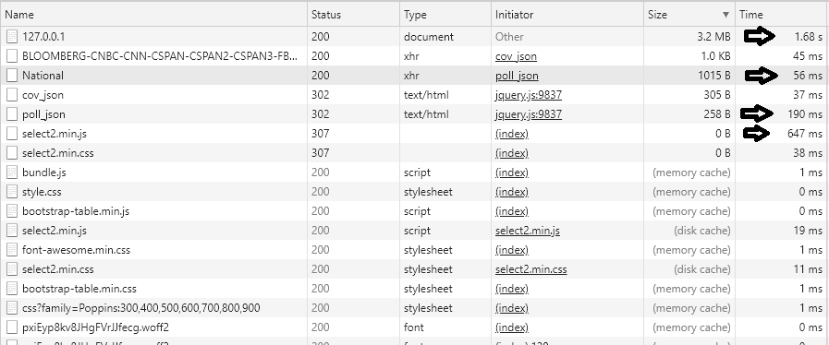
Performance analysis - workload and loading time

Slide 12
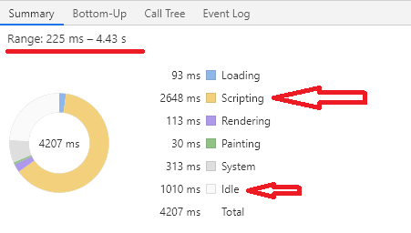
Performance analysis - total loading time

Slide 13
Room for improvement
Better database structure
Deeper insight
Websites coveredge data
More graphs
The use of better statistical tools

Slide 14
What would we change if we started again?
We would spend more time developing a good database structure at the beginning
We wouldn't use Django and SQLite 3
Look into Vue.js for a more modular front end design. This could be paired with a lightweight Flask backend that delivers the data.

Slide 15
What we learned?
It is worth choosing known and well supported technologies
A well thought-out database structure is the very important for such projects…
...but cooperation and a good atmosphere in the team are the most important
We gained valuable skills in web-development
We are more efficient in working with external data sets

Slide 16
Thanks for listening!

